Slide 1

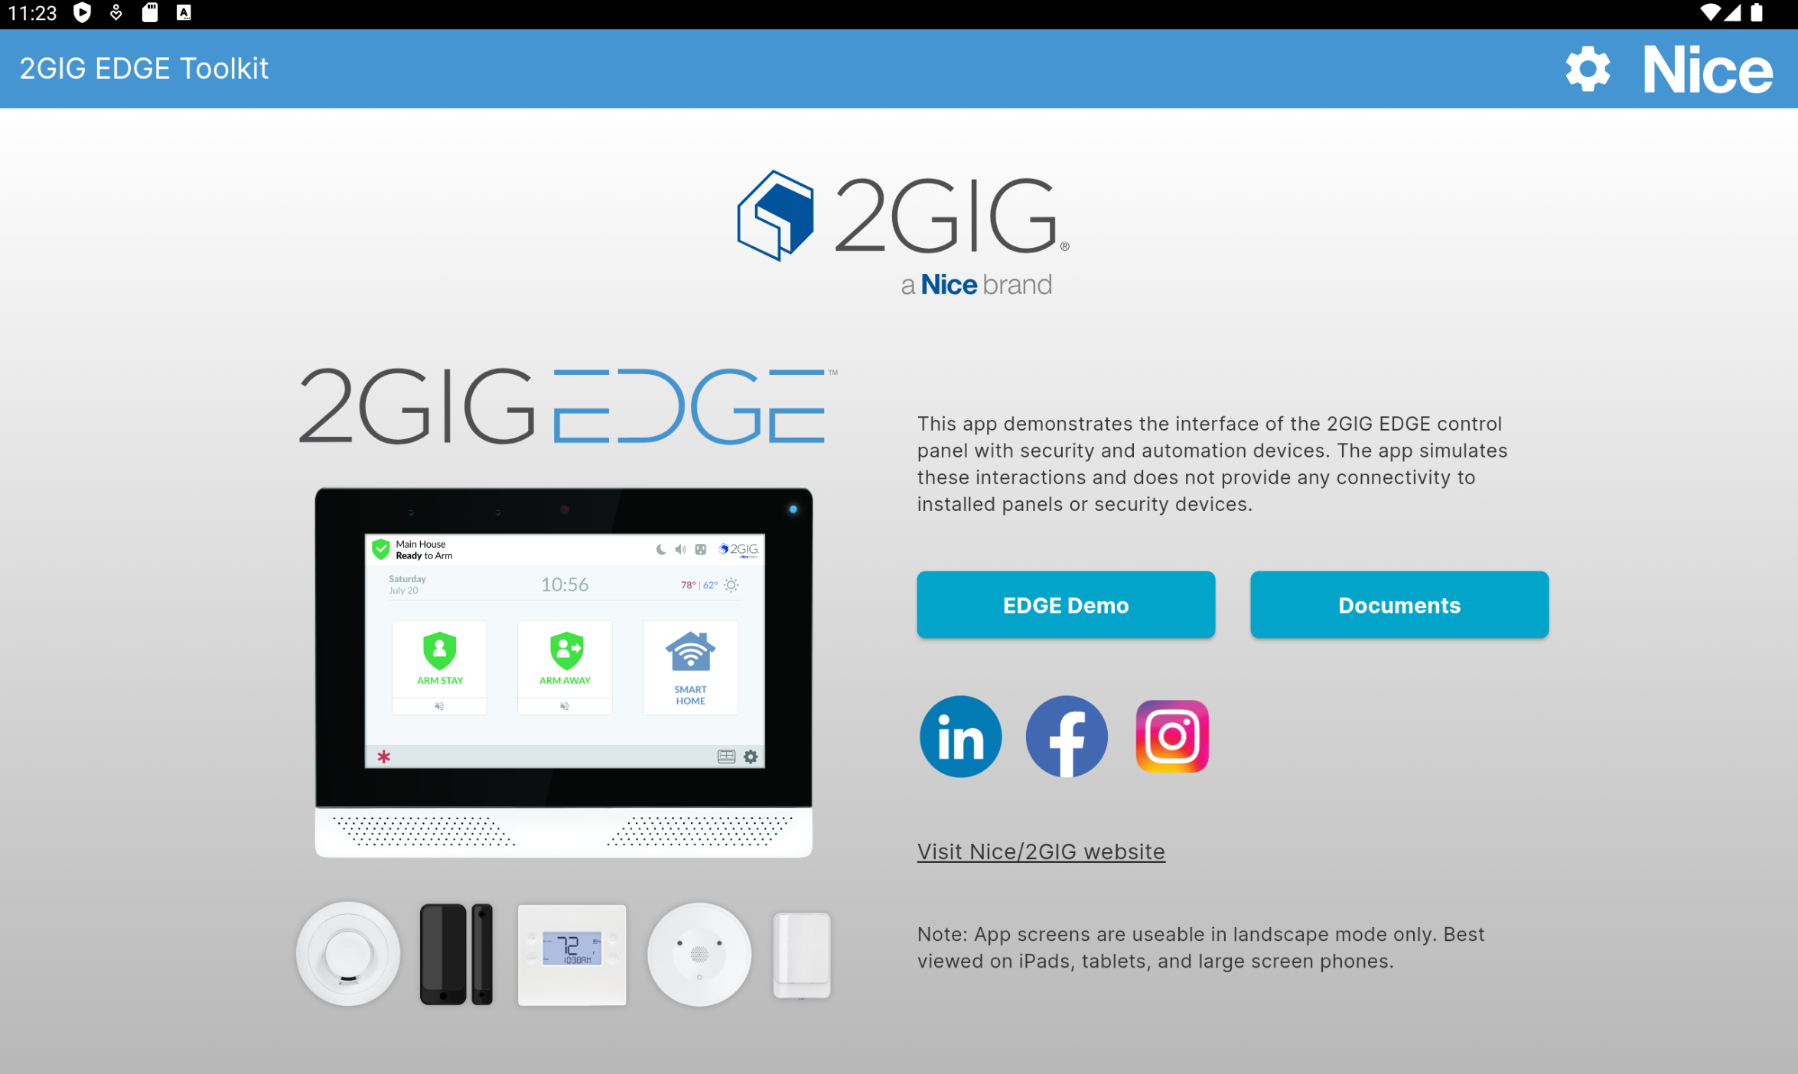
Nice North America - 2GIG EDGE Toolkit App
Business Need
Nice Security, a leader in smart devices and home security, aimed to support its sales team, partners, and customers with a mobile app that could serve as both a sales demo and documentation tool for the 2GIG EDGE security panel.
They needed a mobile and iPad app that emulates the 2GIG EDGE panel’s functions, helping users run live demos and access product documentation.
Outcomes
Designed and delivered a cross-platform app in Flutter replicating the 2GIG EDGE panel’s features
Integrated robust product documentation for sales and customer reference
Optimized usability and ensured seamless performance across devices
Achieved successful app store approval and smooth public launch
Boosted sales demonstrations and improved customer understanding of the product
Earned positive user feedback for accessibility and engagement impact
Strengthened Nice Security’s position as a leader in the smart home market

